Slide 1
Lead Management in Salesforce
Independent Project: Use Salesforce to Identify Sales Prospects
Shaquana Brazill

Slide 2

Part A
Overview
1
Task 1: Structure and Download Lead Data
2
Task 2: Import Data in Salesforce
3
Task 3: Create a List View and Filter for Leads
4
Task 4: Associate Leads With a Campaign
5
Task 5: Business Case Analysis

Slide 3
Part A, Task 1: Structure and Download Lead Data
After you’ve finished cleaning up the data and fixing all the errors in the spreadsheet data, insert a screenshot of all the lead data in your spreadsheet. Make sure you can see all the columns, including:
Replace the text box on the following slide with your screenshot
First Name
Last Name
Title
Company
Phone Number
Email

Slide 4
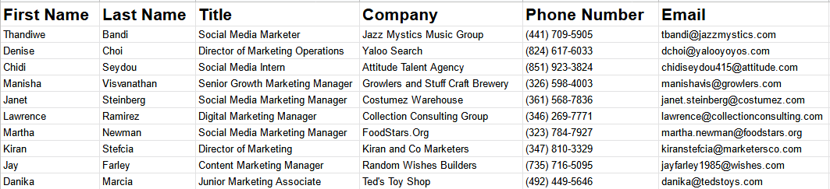
Part A, Task 1: Screenshot

Slide 5
Part A, Task 2: Import Data in Salesforce
Navigate to the App launcher and open the Sales app to the Leads tab. Organize the lead list so that the most recently created leads appar first. Then, insert a screenshot to show all 10 of the leads that you’ve just uploaded on the following slide.

Slide 6
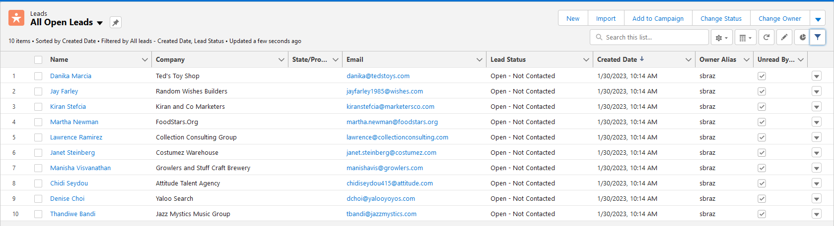
Part A, Task 2: Screenshot

Slide 7
Part A, Task 3: Create a List View and Filter for Leads
Insert screenshots of the Demo leads list view for each of the steps below in the following slides. Your screenshots should show that you’ve:
Step 1: Created a clone of the leads view titled “Demo Leads”
Step 2: Added a filter to only be able to see leads that are open and haven’t been contacted
Step 3: Made sure all noted fields are visible and in the right order
Step 4: Created a separate tab for the leads.

Slide 8
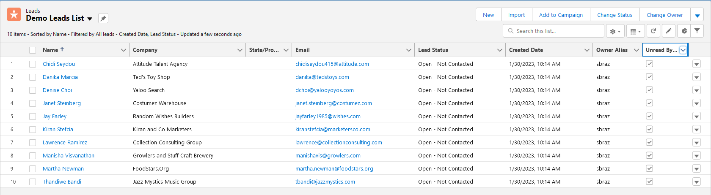
Part A, Task 3: Step 1 screenshot

Slide 9
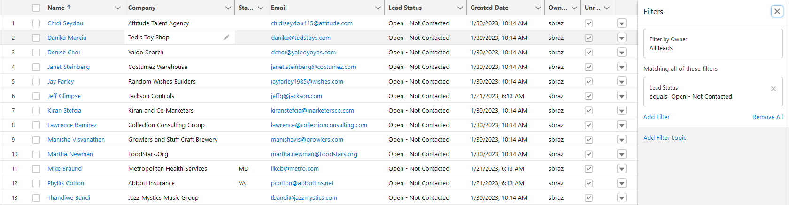
Part A, Task 3: Step 2 screenshot
Notes:
All of the leads are already open- not contacted. Once the filter is placed, it adds three other leads that were not imported from the csv spreadsheet. If we aren’t working with pre-populated data, why does this occur?

Slide 10
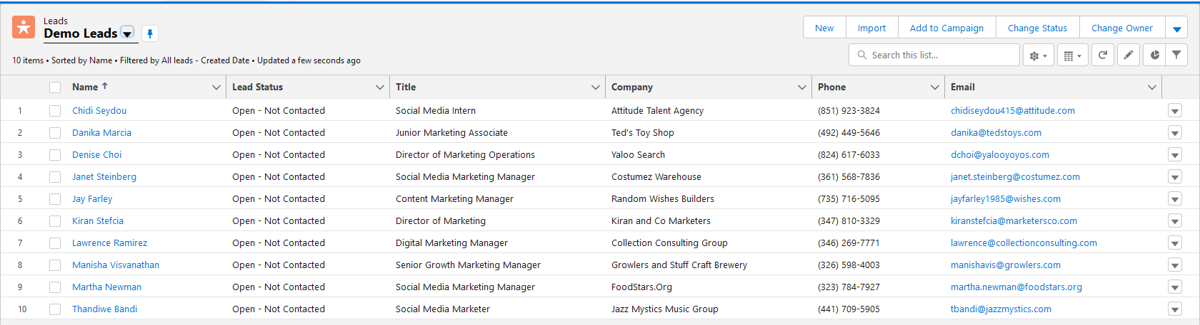
Part A, Task 3: Step 3 screenshot

Slide 11
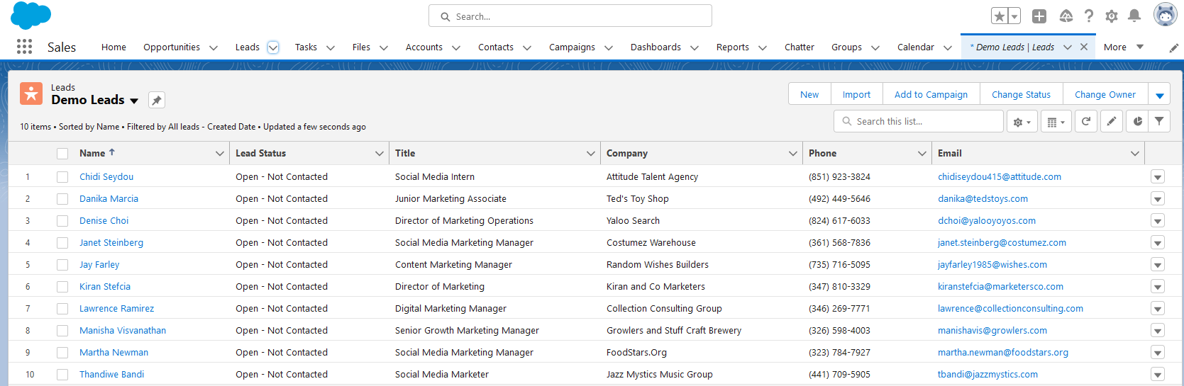
Part A, Task 3: Step 4 screenshot

Slide 12
Part A, Task 4: Associate Your Leads with a Campaign
After you’ve associated all 10 leads with the new campaign, navigate to the Campaigns tab of your Sales app. Take a screenshot of the Campaign Members page of the Social Media Conference Email that shows all the leads you’ve just associated with this campaign, and insert it on the next slide.

Slide 13
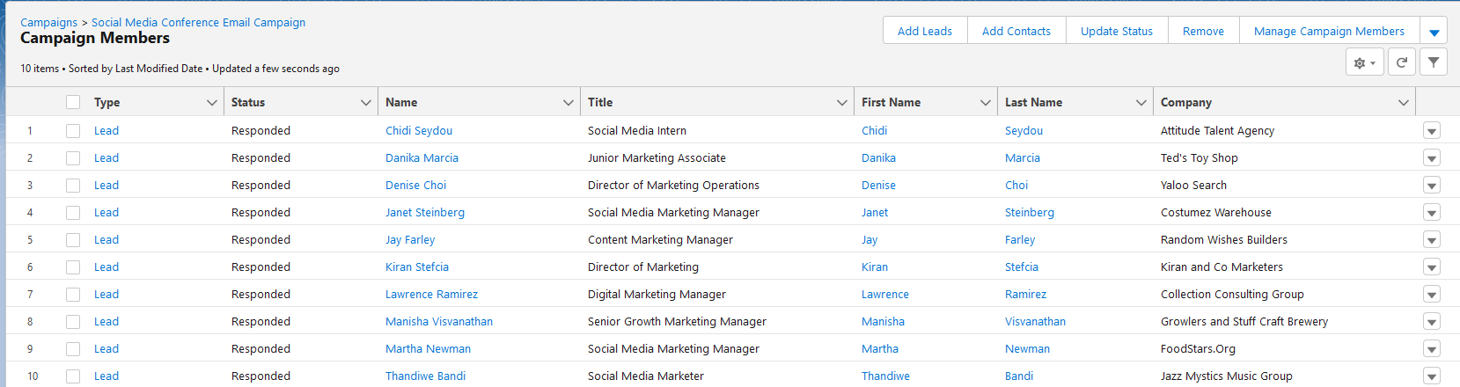
Part A, Task 4: Screenshot

Slide 14
Part A, Task 5: Business Case Analysis
In a short paragraph on the following slide, describe how importing and organizing data in Salesforce would help the sales and marketing teams SimplySocial. In your description, include:
The overall purpose of importing and organizing data.
The major steps you took to import and organize data.
How the sales and marketing teams at SimplySocial would benefit from imported and organized lead data in Salesforce.

Slide 15
Part A, Task 5: Written response
Importing and organizing data into Salesforce would insure that it is recorded and referenced for usage at any time. With salesforce, users can maintain digital logs of customer data for increased reliability. Every part of the sales process can be documented and analyzed for statistical purposes. It takes no time at all to record lead data into a csv file and import into Salesforce for editing; once uploaded, the data can be organized as the user permits.

Slide 16

You have reached the end of Part A!
Make sure your screenshots are embedded in the appropriate slides before moving on. Note that you will complete Part B of this Independent Project at the end of Week 4.

Slide 17
Part B
Overview
1
Task 1: Filter Leads to Decide Who to Approach
2
Task 2: Initiate Contact With Leads via Email
3
Task 3: Continue Contact With Leads via Calls
4
Task 4: Mark Leads as Hot
5
Task 5: Create Email Templates
6
Task 6: Convert Leads

Slide 18
Part B Task 1: Filter Leads
After creating the necessary filter for the Demo Leads list, insert a screenshot showing the list with the leads filtered by manager. Make sure to adjust the size of the Title column so that all the leads’ titles can be read.

Slide 19
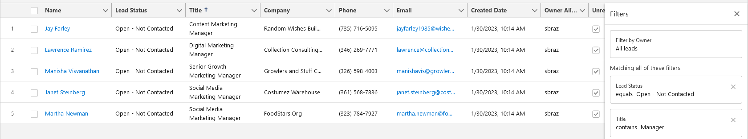
Part B Task 1: Screenshot

Slide 20
Part B Task 2: Initiate Contact with Leads via Email
Insert screenshots to show that you’ve emailed Janet, Thandiwe, Martha, and Denise. Your screenshots should display the past activities log for each of these leads showing that you have sent them an email. The past activities log is at the bottom of the Activity tab.
Step 1: Past activity for Janet Steinberg showing you’ve emailed them.
Step 2: Past activity for Thandiwe Bandi showing you’ve emailed them.
Step 3: Past activity for Martha Newman showing you’ve emailed them.
Step 4: Past activity for Denise Choi showing you’ve emailed them.

Slide 21
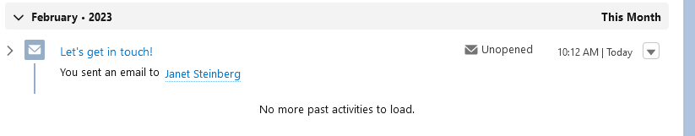
Part B Task 2: Step 1 screenshot

Slide 22
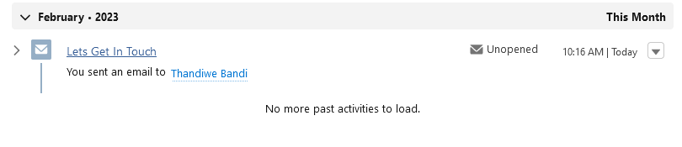
Part B Task 2: Step 2 screenshot

Slide 23
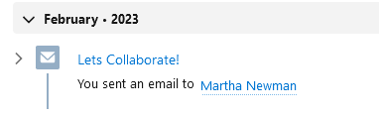
Part B Task 2: Step 3 screenshot

Slide 24
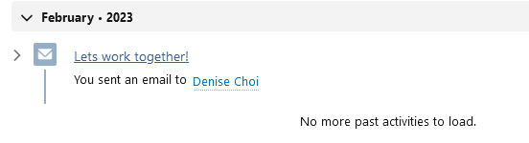
Part B Task 2: Step 4 screenshot

Slide 25
Part B Task 3: Continue Contact with Leads via Calls
Insert screenshots for the calls with the four leads. Make sure your screenshots display the past activity logs for each of these leads showing that calls, notes, tasks, and/or emails have been logged with each of them. The past activities log is at the bottom of the Activity tab.
Step 1: Past activity for Janet Steinberg showing logged activities.
Step 2: Past activity for Thandiwe Bandi showing logged activities.
Step 3: Past activity for Martha Newman showing logged activities.
Step 4: Past activity for Denise Choi showing logged activities.

Slide 26
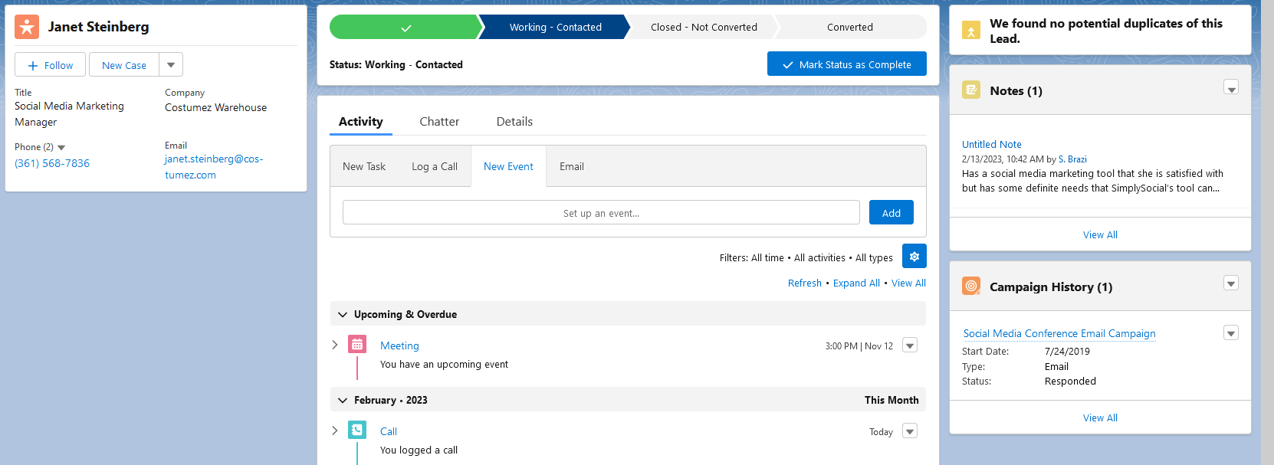
Part B Task 3: Step 1 screenshot

Slide 27
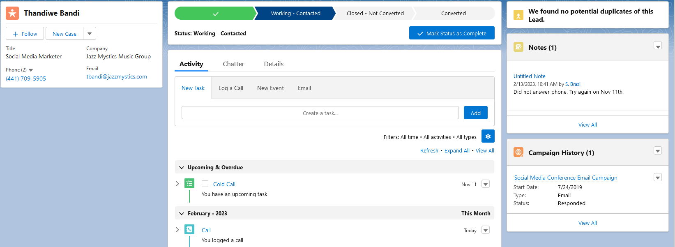
Part B Task 3: Step 2 screenshot

Slide 28
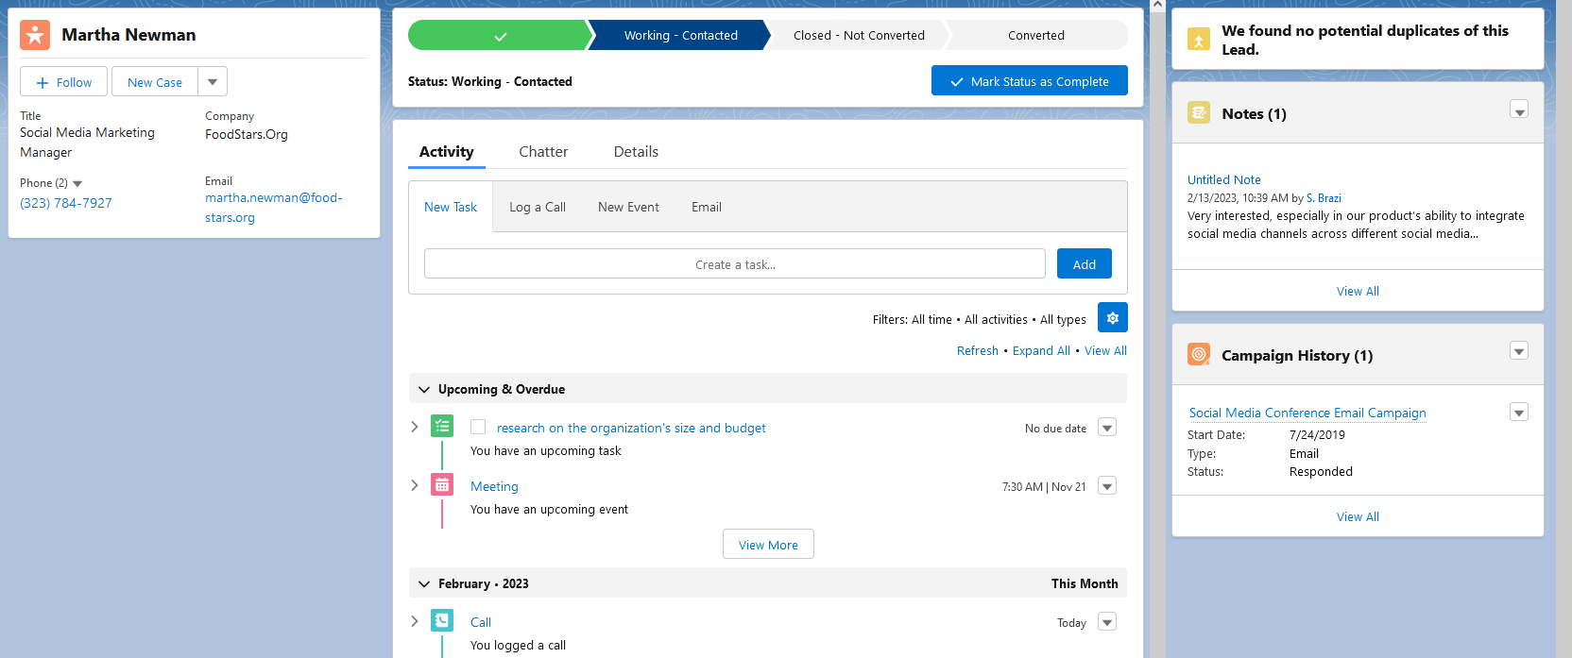
Part B Task 3: Step 3 screenshot

Slide 29
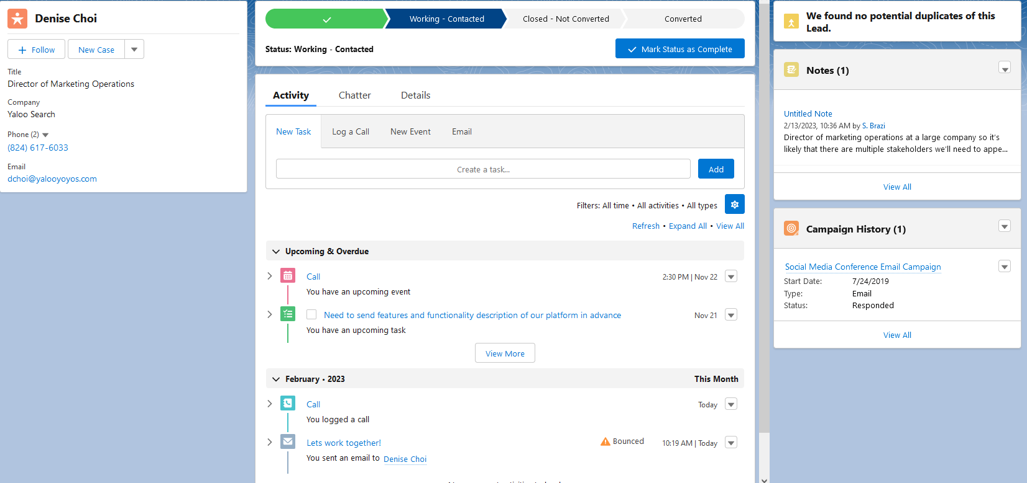
Part B Task 3: Step 4 screenshot

Slide 30
Part B Task 4: Mark Leads as Hot
Insert a screenshot showing the leads marked as hot and warm on the leads list. Make sure that “Rating” is a displayed field on the leads list and that you have organized the list so that hot and warm leads appear first. The leads that appear marked as hot and warm may include leads that pre-existed in Salesforce before you imported your leads.

Slide 31
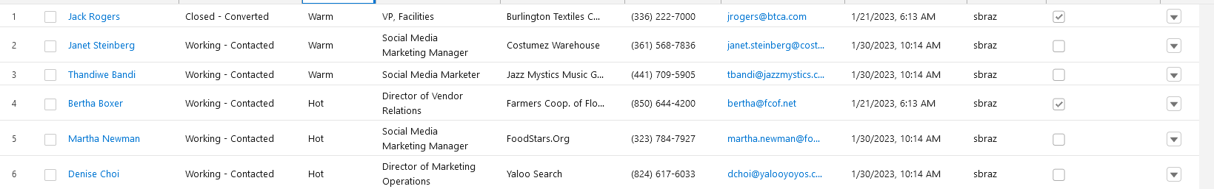
Part B Task 4: Screenshot

Slide 32
Part B Task 5: Create Email Templates
Insert a screenshot showing an email that can be sent to either Martha Newsom or Denise Choi. The email should include a merge field for the recipient’s first name.

Slide 33
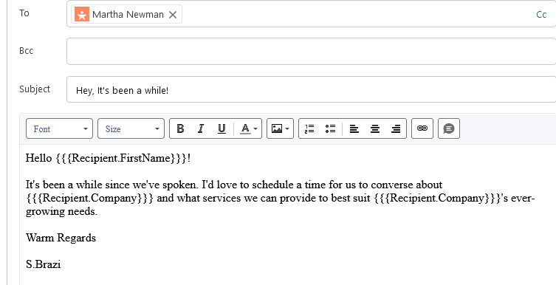
Part B Task 5: Screenshot

Slide 34
Part B Task 6: Convert Leads
Insert screenshots on the following slides to show the updates you’ve made to each lead according to the directions below:
Step 1: Screenshot Thandiwe Bandi’s lead record page.
Make sure your screenshot shows the lead’s name, the note you created, and that their lead status in the lead path is updated to Closed — Not Converted.
Step 2: Screenshot Janet Steinberg’s lead record page.
Make sure your screenshot shows the lead’s name, the note you created, and that their lead status in the lead path is updated to Closed — Not Converted.
Step 3: Screenshot the popup after converting Martha Newman.
This is the popup labeled “Your lead has been converted”. Make sure that the screenshot shows the Account, Contact, and Opportunity that have been created.
Step 4: Screenshot the popup after converting Denise Choi.
Make sure to show that an Account, Contact, and Opportunity have been created.

Slide 35
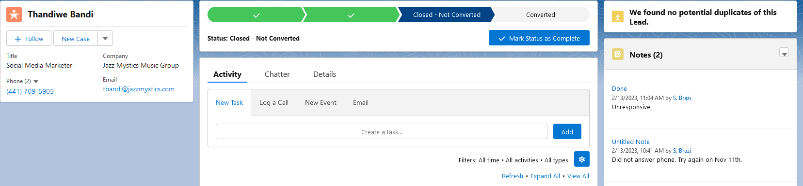
Part B Task 6: Step 1 screenshot

Slide 36
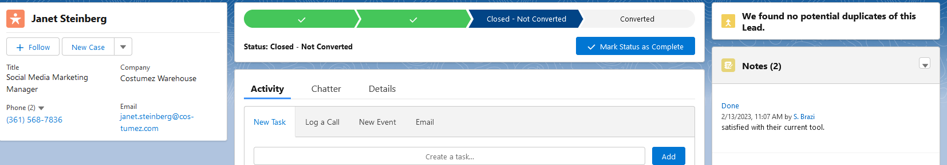
Part B Task 6: Step 2 screenshot

Slide 37
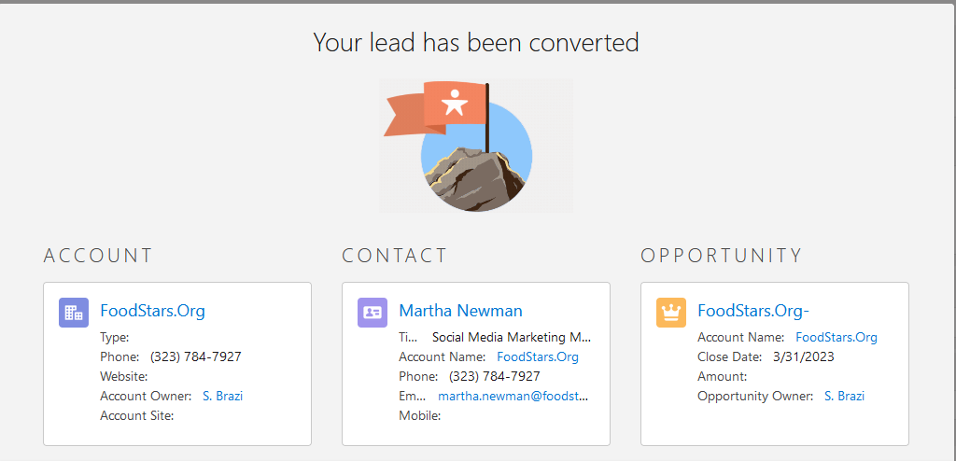
Part B Task 6: Step 3 screenshot

Slide 38
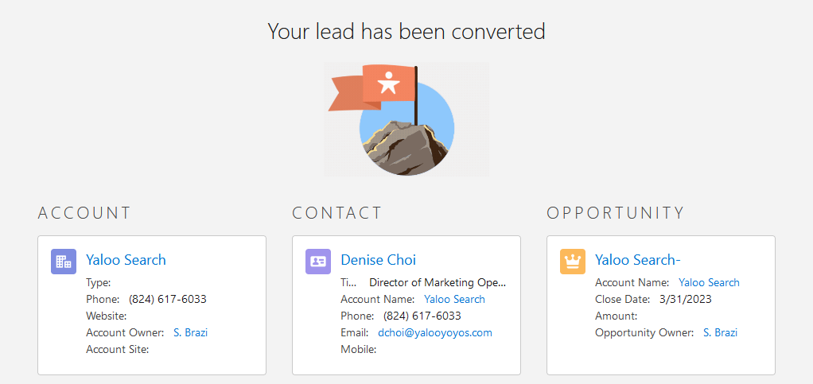
Part B Task 6: Step 4 screenshot

Slide 39
You have reached the end of Part B!
This is the end of this Independent Project! Great job completing all these tasks in Salesforce. Make sure you download a copy for your portfolio.

